Slide 1
Project Presentation
Topic :
Simulating Fast Fourier Transform in Raspberry Pi
By:
Banoth Jaipal (22117030)
Mentor
Dr. S. Ghosh Sir

Slide 2
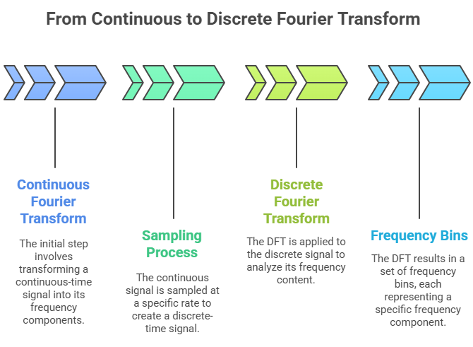
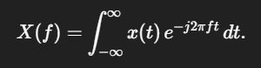
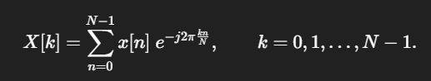
Why go to the frequency domain?
A time-domain signal x(t) (or x[n] after sampling) shows “what happens when” — how amplitude changes with time. But many important properties are about frequency: the presence of tones, harmonics, carrier frequencies, spectral noise shape, etc.
The Fourier transform answers:
What sinusoidal components (frequencies) and with what amplitudes/phases combine to make this signal?
That answer is the frequency-domain representation X(f). For computers and sampled signals we use discrete transforms (DFT/FFT). The FFT is simply an efficient way to compute the DFT.

Slide 3
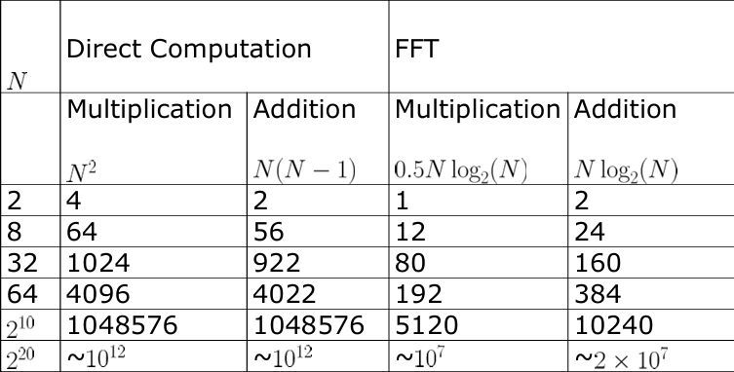
Fast Fourier Transform ,What and Why?
FFT analysis is one of the most used techniques when performing signal analysis across several application domains. FFT transforms signals from the time domain to the frequency domain. FFT is the abbreviation of Fast Fourier Transform.
Using FFT analysis, numerous signal characteristics can be investigated to a much greater extent than when inspecting the time domain data. In the frequency domain, the signal characteristics are described by independent frequency components, wherein the time domain it is described by one waveform, containing the sum of all characteristics.
Computing the DFT directly requires O(N^2) complex multiplications (because for each k you sum over n).
The FFT is an algorithmic trick (Cooley–Tukey and variants) that reorganizes the computation to reuse arithmetic and reduces complexity to O(Nlog⁡N) That huge reduction is why real-time spectral plotting is practical.
The FFT divides the problem into smaller DFTs (divide-and-conquer), uses symmetry of roots of unity, and combines results

Slide 4
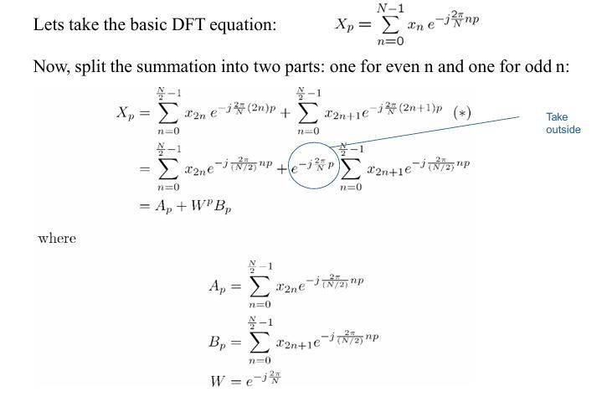
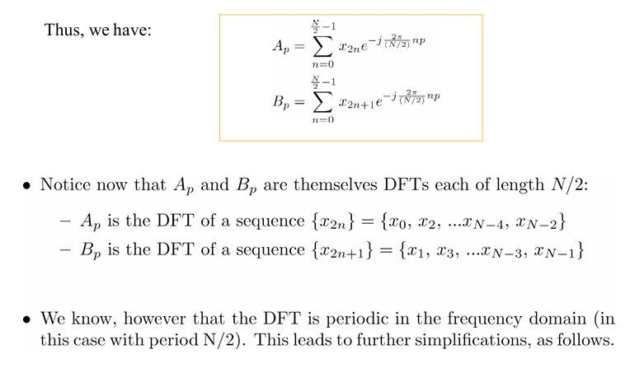
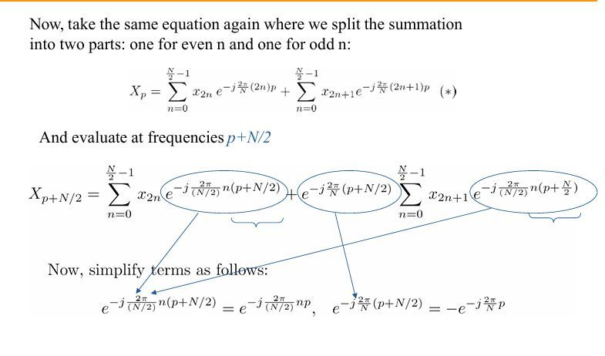
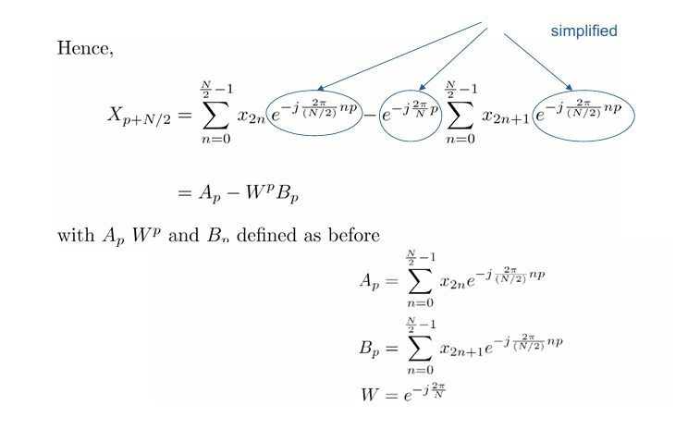

Slide 5
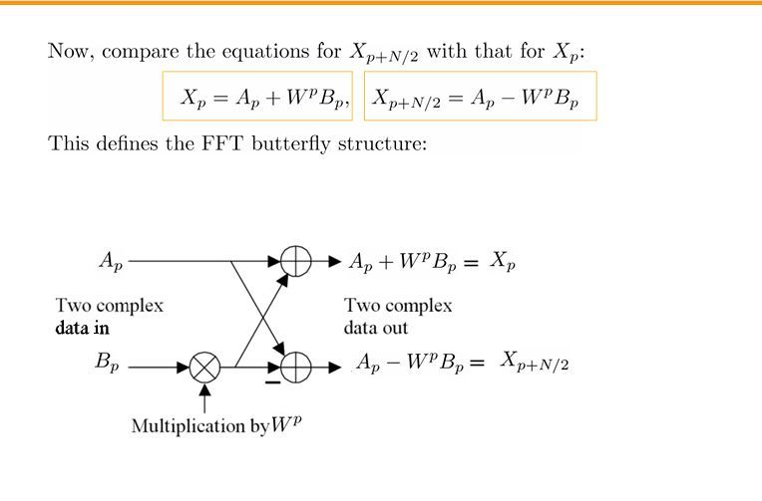
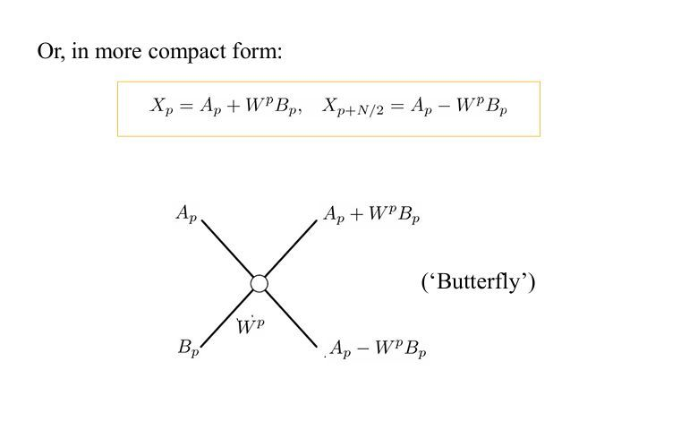

Slide 6
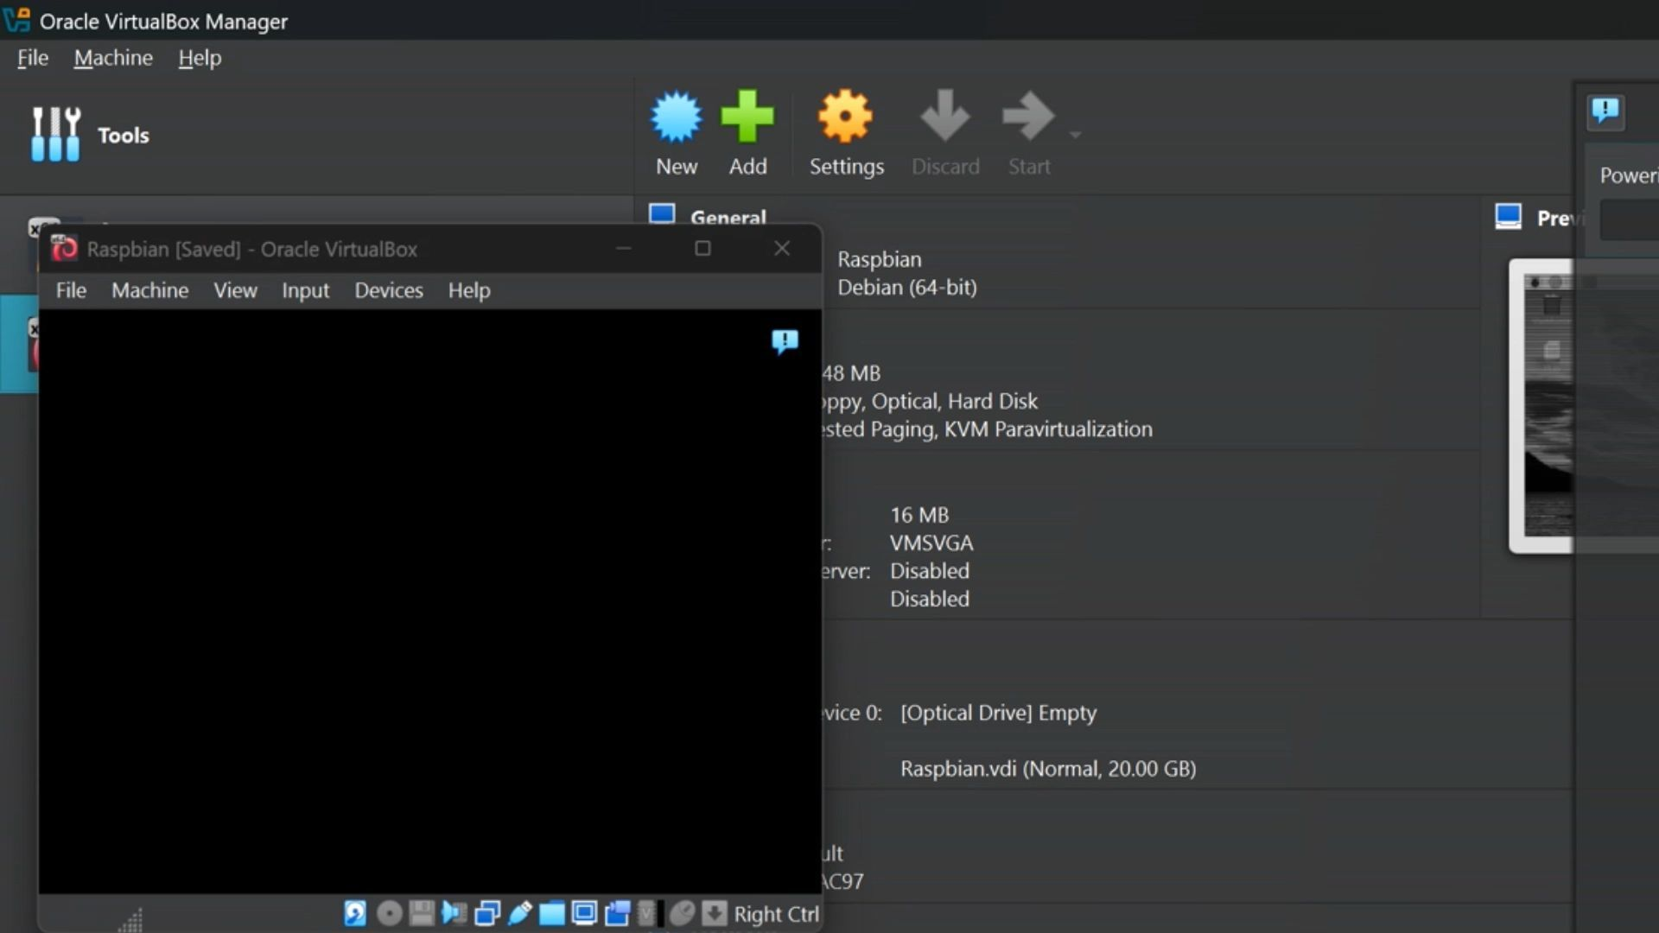
Project Demo

Slide 7
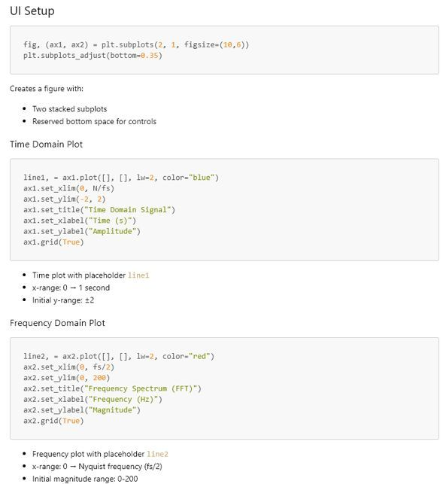
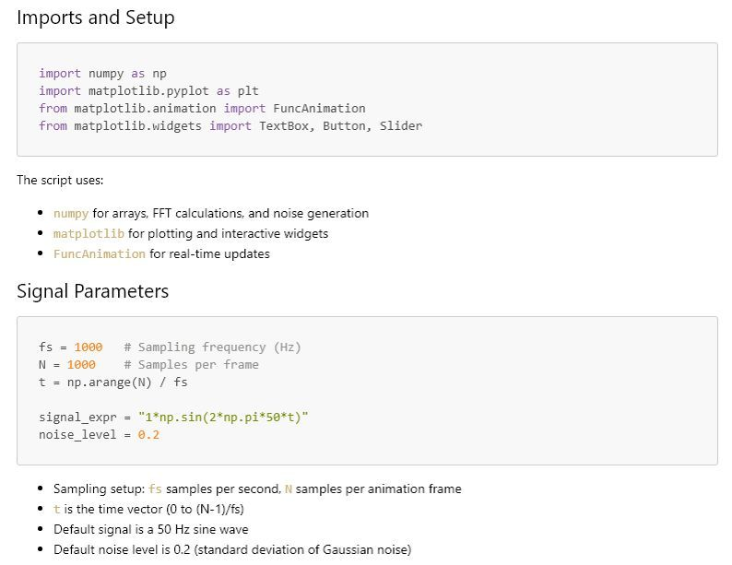
Code Walkthrough

Slide 8
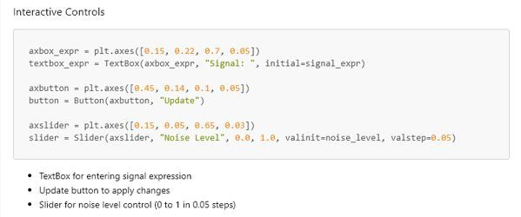
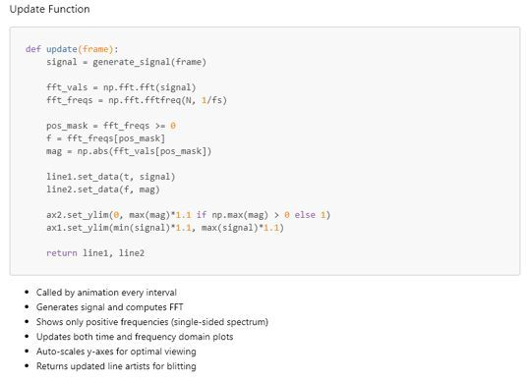
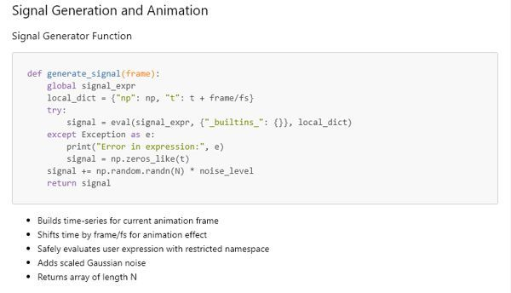
Code Walkthrough

Slide 9
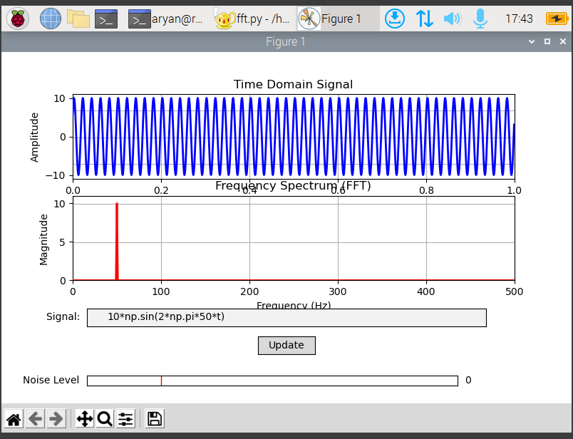
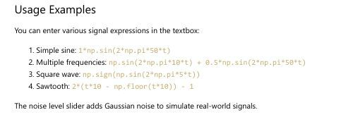
Code Walkthrough

Slide 10
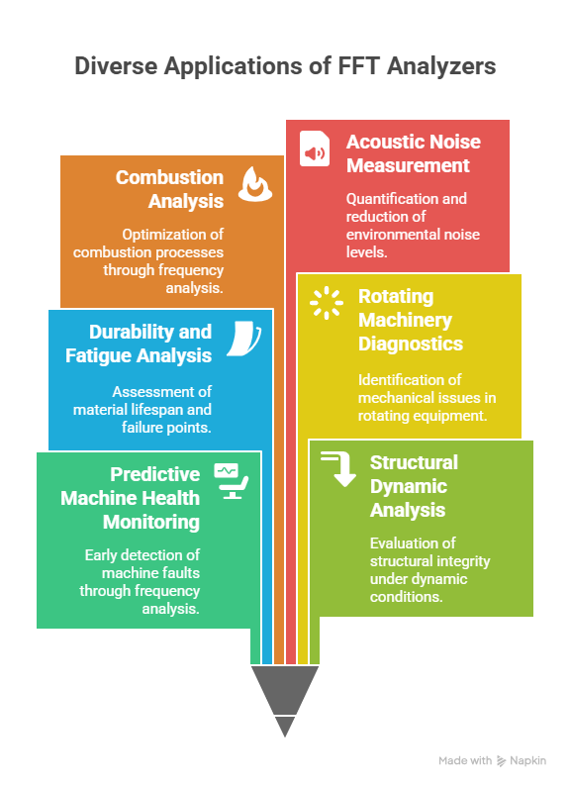

Slide 11
Conclusion
Through this project, I successfully designed and simulated a real-time signal analyzer that takes a time-domain signal as input and converts it into its frequency-domain representation using the Fast Fourier Transform (FFT).
By implementing this on Raspberry Pi OS I gained the following key learnings:
Signal Representation: Understood how signals can be expressed in both time and frequency domains, and how noise affects them.
Fourier Transform & FFT: Learned the mathematical foundation of FFT, how it decomposes a signal into sinusoidal components, and how the number of FFT points (N) determines the frequency resolution.
Practical FFT Scaling: Understood why raw FFT outputs large values and how normalization brings it back to actual signal amplitudes.
Python Libraries for DSP: Used NumPy for FFT computation and Matplotlib for interactive visualization, gaining hands-on experience with scientific Python.
Interactive Controls: Implemented user inputs (text box, slider, button) to dynamically change signal frequency, amplitude, and noise level, making the project interactive like a real function generator + spectrum analyzer.

Slide 12
Thank You

